Slide 1
DESIGN DOCUMENTATION FOR ELECTRONIC VOTING
Batch:B19
-Likith(020)
-Tarun(050)

Slide 2
Features of our project
Voter
Election Officer
Receive voting instructions
Ask for help
Vote
Change vote
Authorize new election
Suspend election
Restore election
Set election settings

Slide 3
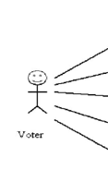

Use case diagram:
List voting options
Cast vote
Make vote selection
Review recorded votes
Register voter
Review results

Slide 4
Use Case Description:
Use case Id:UC01
Name :List voting options
Actors : Voter
Description: This use case lists the candidates and resolutions available in the current election.
Pre Condition : The voter has identified themself.
Post Condition : The possible voting options are displayed.
Main flow:
Voter | System
Selects List voting options
 | Displays list of all the candidates

Slide 5
Use Case Description:
Use case Id:UC02
Name :Cast Vote
Actors : Voter
Description : This use case collects the voter's ballot and sends them to the central receiving authority.
Pre Condition : The voter has reviewed and accepted their selections.
Post Condition : The votes have been confirmed by the central receiving authority.
Main flow:
Voter | System
Selects cast vote option
 | Collects the voters ballot and sends them to the authority

Slide 6
Use Case Description:
Use case Id:UC03
Name :Make vote selection
Actors : Voter
Description : This use case records a voter's selection for an individual race or resolution.
Pre Condition : The voter has selected an election in which to vote.
Post Condition : The voter has made a valid selection in an election.
Main flow:
Voter | System
Selects make vote selection option
 | Records a voters selection for an individual race

Slide 7
Use Case Description:
Use case Id:UC04
Name : Review recorded votes
Actors : Voter
Description: This use case displays the voter's ballot to them as recorded locally and as recorded by the central voting authority.
Pre Condition: The votes have been received without error at the reviewing authority.
Post Condition: The voter confirms that the votes have been properly received.
Main flow:
Voter | System
Selects review recorded votes option
 | Displays the voter’s ballot

Slide 8
Use Case Description:
Use case Id:UC05
Name : Register voter
Actors : Election Official
Description: This use case allows an Election Official to enter the list of registered voters for an election.
Pre Condition: The voting system has been properly initialized.
Post Condition: The voter has been confirmed to be eligible to vote.
Main flow:
Election Official | System
Selects register voter option
 | Allows him to enter the lists of registered voters

Slide 9
Use Case Description:
Use case Id:UC06
Name : Review results
Actors : Election Official
Description: This use case displays the election results to the election official.
Pre Condition: At least one voter has voted in the election.
Post Condition: A summary of the current results are displayed.
Main flow:
Election Official | System
Selects review result option
 | Displays the election results to the election official

Slide 10
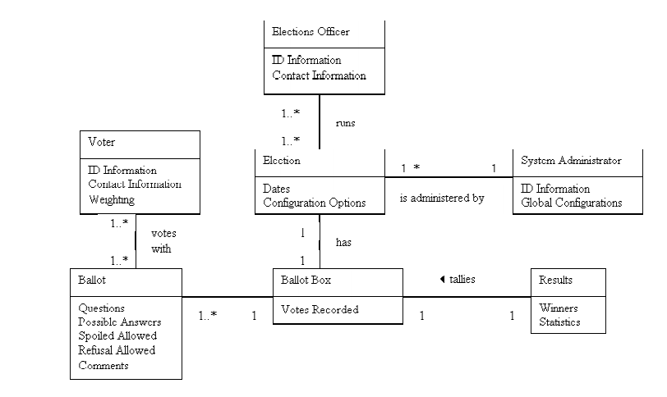
Use Case Diagram for Reference:

Slide 11
THANK YOU

